Slide 1
Efficient AI on RISC-V Matrix How to accelerate GeMM and Convolutions on a RISC-V Matrix (IME, AME, VME) with efficient memory access

Slide 2
NPU (Neural Processing Unit) Block Diagram
Author’s view of the NPU includes
Scalar (CPU)
No data parallelism
Vector Processing Unit (VPU)
1D data parallelism
Execution units, VRF and Vector load/store unit
Matrix Execution Unit (MXU)
2D data parallelism with an array of MACs
May have it’s own register files and matrix load store unit.
Memory
L1D & I Cache. For program, call stack etc. AI weights and activations do not go through L1$
L2 Cache/TCM – Most of this presentation discusses and debates the pros and cons of cache vs TCM.
DMA to read weights and activations from DDR and write the intermediate results and final output to DDR.
NPU
L2 Cache
OR
Tightly Coupled Memory
RISC-V Scalar CPU
I$
D$
RF
LSU
RISC-V Vector (VPU)
EXU
VRF
VLSU
RISC-V Matrix (MXU)
MAC Array
MRF
MLSU
DMA Engine

Slide 3
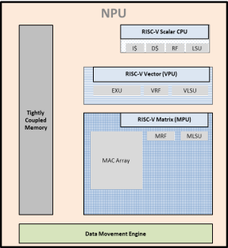
How an NPU sits inside an SoC
SoC
NPU Cluster
Shared L3 Cache
OR
SRAM
Apps CPU
Apps CPU
Apps CPU
Apps CPU
System Interconnect
External Memory Interface
DDR

Slide 4
GeMM Operation using MatMul engine
K
N
N
M
K
M
A
B
C
Each grid square is a tile of the size m_{r}xn_{r}, which is the logical MAC Array size on the matrix HW
a = element width of A, in bits
b = element width of B, in bits
c = element width of C, in bits
C here is the output matrix in memory, and is different from the accumulator tile inside matrix HW.
Input and output matrices are expected to be large, i.e. M, K, N >> m_{r}, n_{r}
Therefore, they are assumed to reside in DDR memory.
Small sections of A and B will be moved closer to NPU as needed.
Computation will happen on small tiles.
Computed result will be moved back to DDR when ready.

Slide 5
Memory Access without BLIS packing
NPU
L2$/TCM
RISC-V Scalar CPU
I$
D$
RF
LSU
RISC-V Vector (VPU)
EXU
VRF
VLSU
RISC-V Matrix (MXU)
MAC Array
MRF
MLSU
All matrices are in row major layout.
Each square is a tile of size m_{r}xn_{r}
DMA Engine
To compute output tile {i,j}
DMA-In one tile from row #i from matrix A
DMA-In one tile from column #j from matrix B
Compute dot product on matrix HW and keep accumulating
Repeat steps 1 and 2 for the whole row #i and column #j
DMA-Out the computed C_tile to matrix C in DDR
Pipeline the DMA with compute for max performance.
This works perfectly as long as column B can be loaded with a non-unit stride from L2

Slide 6
Cache vs TCM
The author recommends using a TCM for the following reasons
Data access pattern is very predictable and structured.
Simple rules through which SW can decide when to bring new data, which data to bring and which data can be discarded.
Deterministic access time and guaranteed performance.
Simpler hardware – no coherence, cache management.
Reduced DDR accesses.
No need to design the system around cache line size.

Slide 7
TCM Size Required
Consider
a = b = c = 8 (INT8)
m_{r} = n_{r} = 128
A and B can be DMAed tile-by-tile. Each tile size = 128x128x8-bit = 16KiB
Total memory needed = A_tile + B_tile + C_tile = 48 KiB
All the tiles needed to be double-buffered (ping-pong) to pipeline with DMA.
Hence, total TCM needed = 96 KiB.
This is independent of input matrix dimensions (M,K,N)
One problem with this approach is that the DDR is accessed in small chunks of 128x128. Each row may reside in a different page and that may cause high DDR access overhead.
Proposed solution in next slide.

Slide 8
Making DDR Access Efficient
NPU
L2$/TCM
RISC-V Scalar CPU
I$
D$
RF
LSU
RISC-V Vector (VPU)
EXU
VRF
VLSU
RISC-V Matrix (MXU)
MAC Array
MRF
MLSU
Instead of fetching one tile at a time
Fetch x tiles from A as a single bulk transfer
Fetch y tiles from B as a single bulk transfer
x = DRAM Page Size / ((a/8)* m_{r})
y = DRAM Page Size / ((b/8)* n_{r})
Do the computations in TCM.
DMA-out y tiles of C in a single bulk write to DDR.
Data Movement Engine (DMA/Prefetch)

Slide 9
TCM Size with efficient DDR access
Consider the following configuration
a = b = c = 8 (INT8)
m_{r} = n_{r} = 128
DRAM Page Size = 2048
x = 2048/(128*1) = 16
y = 2048/(128*1) = 16
Size of A row = 128*128*16 = 256 KiB
Size of B row = 128*128*16 = 256 KiB
Size of C row = 128*128*16 = 256 KiB
All the tiles needed to be double-buffered (ping-pong) to pipeline with DMA.
Hence, total TCM needed = 1.5 MiB.
This is again independent of input matrix dimensions.
However, it varies with input and output data types. For example
a = b = 16 (FP16)
c = 32 (FP32)
m_{r} = n_{r} = 64
DRAM Page Size = 2048
x = 2048/(64*2) = 16
y = 2048/(64*2) = 16
Size of A row = 64*64*16*2 = 128 KiB
Size of B row = 64*64*16*2 = 128 KiB
Size of C row = 64*64*16*4 = 256 KiB
With ping-pong buffering, total TCM needed = 1.0 MiB.

Slide 10
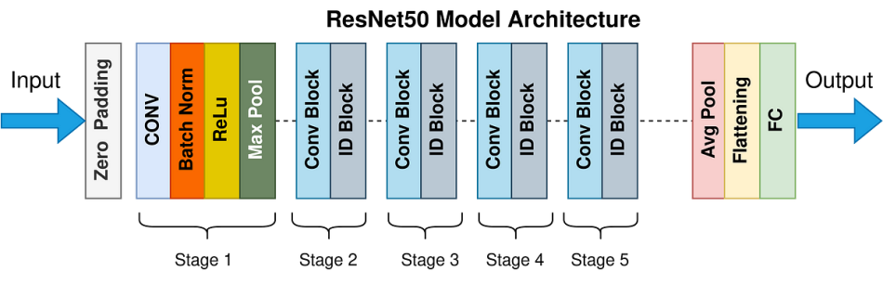
The case for Lo memory
Following the convention of Lo in the document “DesignConsiderationsForVME.pdf”, Lo is one level higher than Lv. In these slides, Lv is the L2 TCM inside NPU core.
Lv memory could be
Shared SRAM inside a cluster of NPUs
OR
SoC wide SRAM outside the NPU cluster
In any case, Lo would serve the purpose of acting as a scratch pad buffer between successive layers of an AI network. Take Resnet50 as an example.
Lv Memory
With the exception of Residual layers, output of layer #N is the sole input to Layer (N+1). Therefore, layer #N output can be discarded after layer #N+1 is processed. If the intermediate outputs can be kept in Lo memory, that saves 1 DDR roundtrip. For e.g. a Conv2d layer generates the output tensor of size n*H*W*C. Maxpool layer reduces it to n*(H/2)*(W/2)*C which is 1/4th the size. We can avoid one write and one read of Conv2d layer output if it can be held in on-chip memory. This can be continued across several layers. In practice, this technique has been proven to reduce DDR traffic by up to 80%. Since DDR b/w is the most precious resource, this optimization results in direct performance gain.
This is one of the many reasons why Lo memory should not be a cache. The author assumes here that all writes to a cache will be posted-writes i.e. always go to the DDR. By choosing SRAM instead of cache, we can avoid all the unnecessary traffic, resulting in higher performance and lower power.

Slide 11
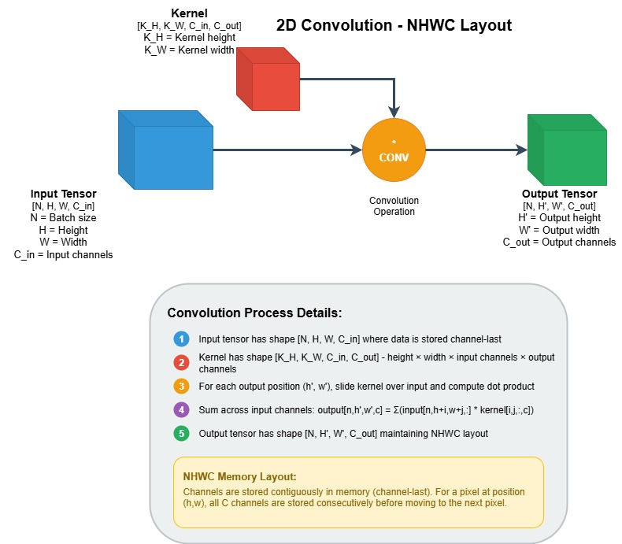
2D Convolution

Slide 12
2D Convolution using Matmul Engine
We use the following dimensions to parallelize
Width of the input tensor
Depth of the weight tensor
The inner most loop, fetches a 2D tile from input tensor and a 2D tile from the weight tensor. The text in red color shows memory access pattern. Since this is the innermost dimension of the tensors in NHWC layout, this memory access is very efficient.
Output is also generated in NHWC layout, as shown in blue color. This is important since this tensor will be the input to another layer in the network.
If W_out and C_out are multiples of m_{r} and n_{r} respectively, then this operation gets done at 100% efficiency without the need for any BLIS packing.
def conv_nhwc(in_tensor, wt_tensor):
N,H_in,W_in,C_in = in_tensor.shape
k,_,_,C_out = wt_tensor.shape
num_cycles = 0
H_out = H_in-k+1 #Height of output channel
W_out = W_in-k+1 #Width of output channel
for n in range(N):
for y in range(H_out):
for i in range(k):
for j in range(k):
for c_out in range(0,C_out,T): #parallelization dimension2
for x in range(0,W_out,T): #parallelization dimension1
for c_in in range(0,C_in,T):
in_tile = in_tensor[n,y+i,x+j:x+j+T,c_in:c_in+T] #input tile of size TxT
wt_tile = wt_tensor[i,j,c_in:c_in+T,c_out:c_out+T] #weight tile of size TxT
out_tile += tiled_dot_product(in_tile, wt_tile) #output tile of size TxT
out[n,y,x:x+T,c_out:c_out+T] = out_tile
T = tile size
This example assumes square tiles i.e. T = m_{r} = n_{r}

